Slide 1

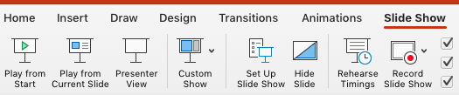



Teaching Notes: Unit & Lesson Slides
Teaching Notes
The content, vocabulary, videos and activities shown on the following slides come directly from your student and teacher text. PDFs are referenced on slides and can be downloaded at Ed: Your Friend in Learning (Ed: YFIL)
All slide content is editable, as you may add, remove or edit content to meet your individual classroom needs.
It is recommended that students utilize an evidence notebook as they ask questions and collect evidence and data throughout. Look for the notebook icon in the upper right corner of those slides.
It is recommended that you play the slideshow when using for instruction:
Note: Some videos may not play when opened with Google Slides. All videos can be found in the Student & Teacher eBooks.

Slide 2
Teaching Suggestions: In-Person, Remote or Hybrid
Teaching Notes
This editable, flexible resource can be used in a growing number of ways to meet your needs while supporting remote, hybrid or in-person teaching and learning for all:
In-person instructional and learning tool for teachers and students
Digital or remote presentation tool for online or virtual meetings
Easy-to-follow for parent-led instruction or substitute teachers
Flipped model instructional support for student distance learning
Student collaboration or alternative to collecting student responses

Slide 3
HMH Science Dimensions
Biology
Unit 9: The Living Systems
Lesson 3: Adaptive Value of Behavior
Notes:
The learning experiences in this unit prepare students for the mastery of
Performance Expectations
LS1-2 Develop and use a model to illustrate the hierarchical organization of interacting systems that provide specific functions within multicellular organisms.
LS1-3 Plan and conduct an investigation to provide evidence that feedback mechanisms maintain homeostasis.
ETS1-2 Design a solution to a complex real-world problem by breaking it down into smaller, more manageable problems that can be solved through engineering.
ETS1-3 Evaluate a solution to a complex real-world problem based on prioritized criteria and trade-offs that account for a range of constraints, including cost, safety, reliability, and aesthetics, as well as possible social, cultural, and environmental impacts.

Slide 4
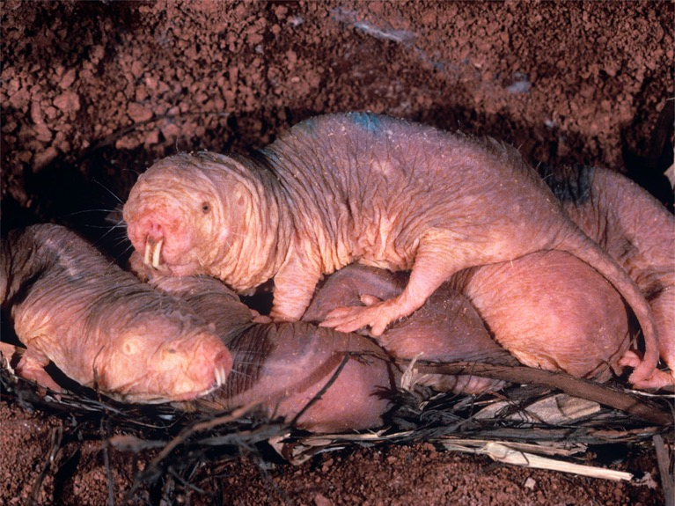
Can You Explain It?
Unit 9 Lesson 3
How could a population, such as the naked mole rats, evolve to the point where not all individuals reproduce?
GATHER EVIDENCE
As you explore the lesson, make a list of questions you have about the social system of the naked mole rat. Return to your list throughout the lesson.
A colony of naked mole rats has a single queen and many workers.
Notes:
Build on Prior Lessons
In Lesson 2, students learned about the evolution of new species and the expansion and extinction of existing species. Lesson 3 builds on these concepts as students explore behavioral adaptations of species
Lesson Objective
Construct explanations about the evolution of group behavior.

Slide 5
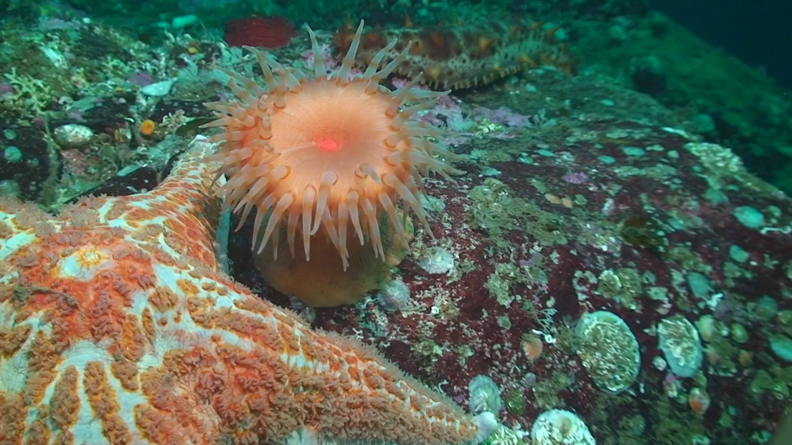
Evolution of Behavior
Unit 9 Lesson 3
How do you think the sea anemone knows when it comes into contact with a sea star versus some other object?

Slide 6
Evolution of Behavior
Unit 9 Lesson 3
The environment of every organism constantly changes and in order to thrive, organisms must respond to these changes.
Anything that triggers a response is called a stimulus.
An internal stimulus triggers a response to a change in an organism's internal environment. An external stimulus is any change in the external environment, that causes a response.
Sense organs have specialized cells with receptors that detect changes in the environment and communicate information through nerves to the brain. The brain then sends a message back to the appropriate system, telling it how to respond.

Slide 7
Evolution of Behavior
Unit 9 Lesson 3
MODEL
Draw a model of the processes that occur when you interact with an internal or external stimulus, such as touching something very hot.

Slide 8
Evolution of Behavior
Unit 9 Lesson 3
Innate behaviors, sometimes called an instinctive behaviors, are passed from generation to generation without learning.
An innate behavior is performed correctly the first time an animal tries it, even when the animal has never been exposed to the stimulus that triggers the behavior.
Maintaining a balanced internal state, or homeostasis, is critical to the health and functioning of an organism.

Slide 9
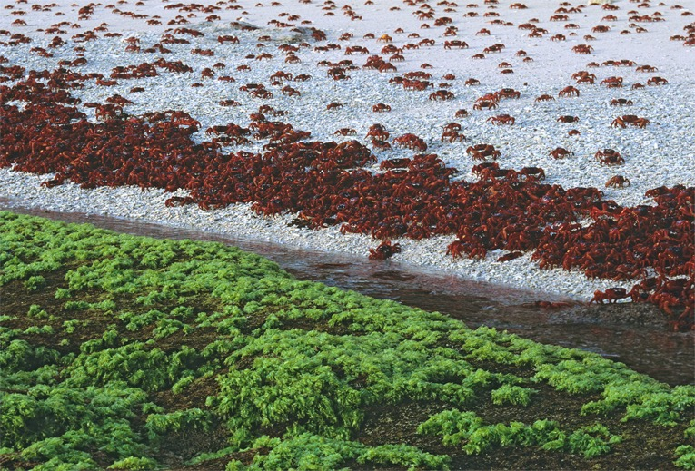
Evolution of Behavior Cause and Effect
Unit 9 Lesson 3
To survive and reproduce, animals need water, food, and shelter.
For many species, this requires individuals to move from one location to another or migrate.
Red crabs migrate during mating season.
According to what you know about natural selection and evolution, how does a behavior evolve, such as mass migration of a species, where all individuals respond in the same way at the same time?

Slide 10
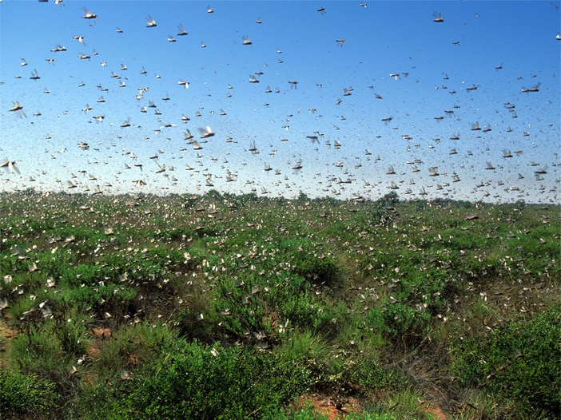
Evolution of Behavior
Unit 9 Lesson 3
A swarm is a large, dense group of animals.
A swarm offers has advantages; swarms confuse predators, swarms also may be better at finding food.
A swarm has disadvantages; the size of a swarm can actually attract predators, a group with more individuals requires greater resources, which must be shared.
Locusts swarm over a field.

Slide 11
Evolution of Behavior
Unit 9 Lesson 3
GATHER EVIDENCE
When would swarming behavior be beneficial and when would it be too costly? How might a behavior such as swarming evolve among species?

Slide 12
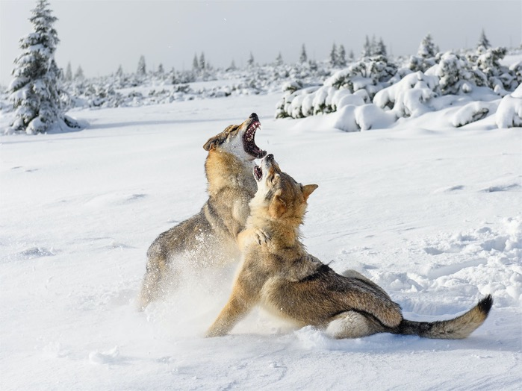
Evolution of Behavior
Unit 9 Lesson 3
Energy costs describe the difference between the energy used in carrying out an activity and the energy used if the individual had done nothing.
One of the main benefits of an innate behavior is that it increases survivorship, or the number of individuals that survive from one year to the next.
This will in turn increase an animal's fitness by natural selection.
Fighting can result in serious injury or even death.

Slide 13
Evolution of Behavior
Unit 9 Lesson 3
ANALYZE
Some spiders build webs that include visible zigzag lines. But more visible webs catch fewer insects than do less visible webs. What benefits do you think the spider gets by building such a visible web?

Slide 14
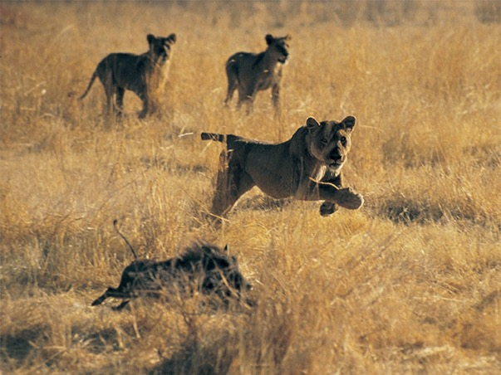
Evolution of Behavior
Unit 9 Lesson 3
All organisms require food to survive.
A solitary hunter only needs to find enough food for itself or its young.
In group hunts, the pack works together to pursue and take down the prey.
Murmurations are a form of group behavior where thousands of starlings flock together as shape-shifting clouds. They are often triggered by the presence of a predator.
Lions hunt in a group.

Slide 15
Evolution of Behavior
Unit 9 Lesson 3
EXPLAIN
Murmurations require a great deal of energy expenditure. Explain the function of this behavior and the cost-benefit relationship. Does the benefit derived from the behavior outweigh the cost?

Slide 16
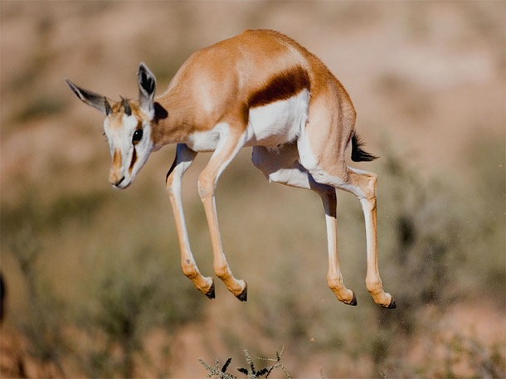
Social Interactions
Unit 9 Lesson 3
Sometimes, springboks hop on all four legs rather than run away when they spot a predator.
This behavior, called pronking, alarms the rest of the herd but makes the individual visible to predators.
Pronking gives the herd enough time to escape and signals to the predator that the herd already spotted it.
Springbok Pronking
Pronking carries with it high energy costs and high risk costs. Why would an individual put itself at risk to alert and protect the rest of the group? What are the potential benefits?

Slide 17
Social Interactions
Unit 9 Lesson 3
Social behaviors include any and all interactions between individuals of the same species. Social groups interact in many ways, such as through communication, mate selection, and defense.
GATHER EVIDENCE
As you view each video showing communication, mate selection, and defense, record your observations of the different behaviors being displayed. Use your observations to explain the function of each behavior and what the advantages are to both the group and the individual. Consider how these behaviors could have evolved.

Slide 18
Social Interactions
Unit 9 Lesson 3
MODEL
Make a model that explains how different types of behaviors benefit the individual, and thereby the group. For each type of behavior, include elements that explain how this trait evolved over time.

Slide 19
Social Interactions
Unit 9 Lesson 3
Lions hunt together in packs, called prides, to increase their chances of success. Most prey can outrun a single lion but not an entire hunting group.
The group works together to stalk the prey and make a barrier to prevent its escape. They then pounce together to take down the prey.
This behavior is an example of cooperation, which involves behaviors that improve the fitness of the individuals involved.

Slide 20
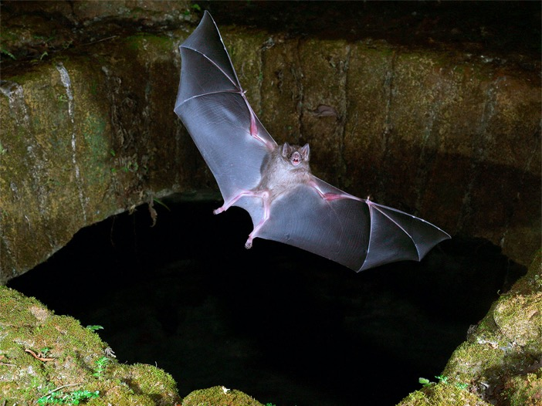
Social Interactions
Unit 9 Lesson 3
Vampire bats keep track of which bats share food and, in turn, will share food with those bats.
This is an example of reciprocity, another form of cooperative behavior among animals.
The idea is that one action, such as sharing food, will result in a future beneficial response, such as being the recipient of shared food.
Vampire bats share food with other bats.

Slide 21
Social Interactions
Unit 9 Lesson 3
Altruism is a kind of behavior in which an animal reduces its own fitness to help other members of its social group. In other words, the animal appears to sacrifice itself for the good of the group
The total number of genes an animal and its relatives contribute to the next generation is called inclusive fitness. It includes both direct fitness from reproduction and indirect fitness from helping kin survive.
When natural selection acts on alleles that favor the survival of close relatives, it is called kin selection.

Slide 22
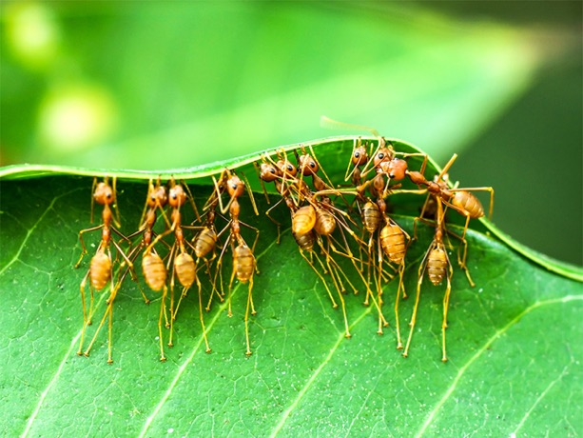
Social Interactions
Unit 9 Lesson 3
If you were to look across many eusocial colonies, you would find that they share a common feature, haplodiploidy.
This means their sex is determined by the number of chromosome sets in an individual. Males are haploid and females are diploid.
How is it possible for a behavior to evolve when there is only one reproductive female and the rest of the colony never reproduces?
Compare and contrast individual behaviors and group behaviors. What requirements are there for these behaviors to evolve?

Slide 23
Learned Behaviors
Unit 9 Lesson 3
Some aspects of behavior are influenced by genes, but many can be modified by experience.
Learned behaviors are actions that change with experience. Learning takes many forms, ranging from changes in behaviors that are largely innate to problem-solving in new situations.
ANALYZE
Is learning genetically controlled? Consider the example of the chimpanzee learning to use tools. Can the chimpanzee pass on what it has learned? Can the chimpanzee pass on the ability to learn? Use evidence to support you claims.

Slide 24
Learned Behaviors
Unit 9 Lesson 3
Cultural behavior is behavior that is spread through a population largely through learning, rather than selection. The key to cultural behavior is that the behavior is taught to one generation by another, known as cultural transmission.
EXPLAIN
Construct an explanation as to how learned and cultural behaviors can increase an individual's fitness.

Slide 25
Unit 9 Lesson 3
Continue Your Exploration
Choose one of the paths below to continue your exploration:
The Evolution of Play Behavior
Examples of Animal Behavior
Using an Ethogram
Career: Animal Behaviorist

Slide 26
Can You Explain It?
Unit 9 Lesson 3
Refer to the notes in your Evidence Notebook to explain why animals, such as naked mole rat workers, evolve not to reproduce.

Slide 27
Image Credits
Unit 9 Lesson 3
mole rats ©Raymond Mendez/Animals Animals/Earth Scenes; swimming anenome video ©Subvision Productions; Christmas Island red crabs ©Universal Images Group/Auscape/Getty Images; locusts ©John Carnemolla/Corbis Documentary/Getty Images; wolves fighting ©johny87/Fotolia; lions hunting ©Digital Vision/Getty Images; springbok pronking ©Gallo Images/Gerald Hinde/Alamy; vampire bat ©Johner Images/Getty Images; ants working together ©Noppharat4569/Shutterstock

